Slide 1
Fitting a Model to Data

Slide 2
What a model is?
What do people mean when they tell you they’re going to “fit a model”?
Let’s start with what a model is.
A model is a description of a system, usually expressed as an equation of some kind.
Let’s say we have some data – measurements of variables x and y.
We think that in the future, we’ll have measurements of more x-like values, and we’d like to be able to predict those y values.
Notes:
https://diamondage.com/2017/06/03/what-does-it-mean-to-fit-a-model-anyway/

Slide 3
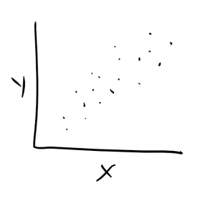
What a model is?
It looks like you could draw a nice straight line through this cloud of points.
That means that a linear model might be a good choice for this data.
We’ve just done the first step in the model-fitting process:
we’ve decided to use a line – a simple linear model.
Process of picking the correct line is called “fitting”.
There are different ways to do this –
least squares is possibly the most familiar one.
That fitted line can be described with the equation y=mx+b.
When we fit the model what we’re really doing is
choosing the values for m and b –
the slope and the intercept.

Slide 4
Fitting a Model
The point of fitting the model is – “to find this equation” –
to find the values of m and b such that y=mx+b describes a line that fits our observed data well.
In the case of the best fit model above, m is close to 1, and b is just a bit larger than 0.
A large m implies that x may have a large effect on y, hence m is also sometimes called the effect size.
It’s also sometimes called a coefficient.

Slide 5
Model representation
Training Set
Learning Algorithm
h
Estimated price

Slide 6
Cost function
A cost function is something you want to minimize. For example, your cost function might be the sum of squared errors over your training set.
Cost function is also called squared error function.

Slide 7
Thanks

